Slide 1


Slide 2





MAS Digital Fabrication
Generative Art
Can a computer create art?

Slide 3
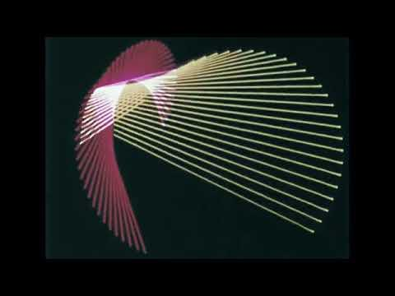

Slide 4
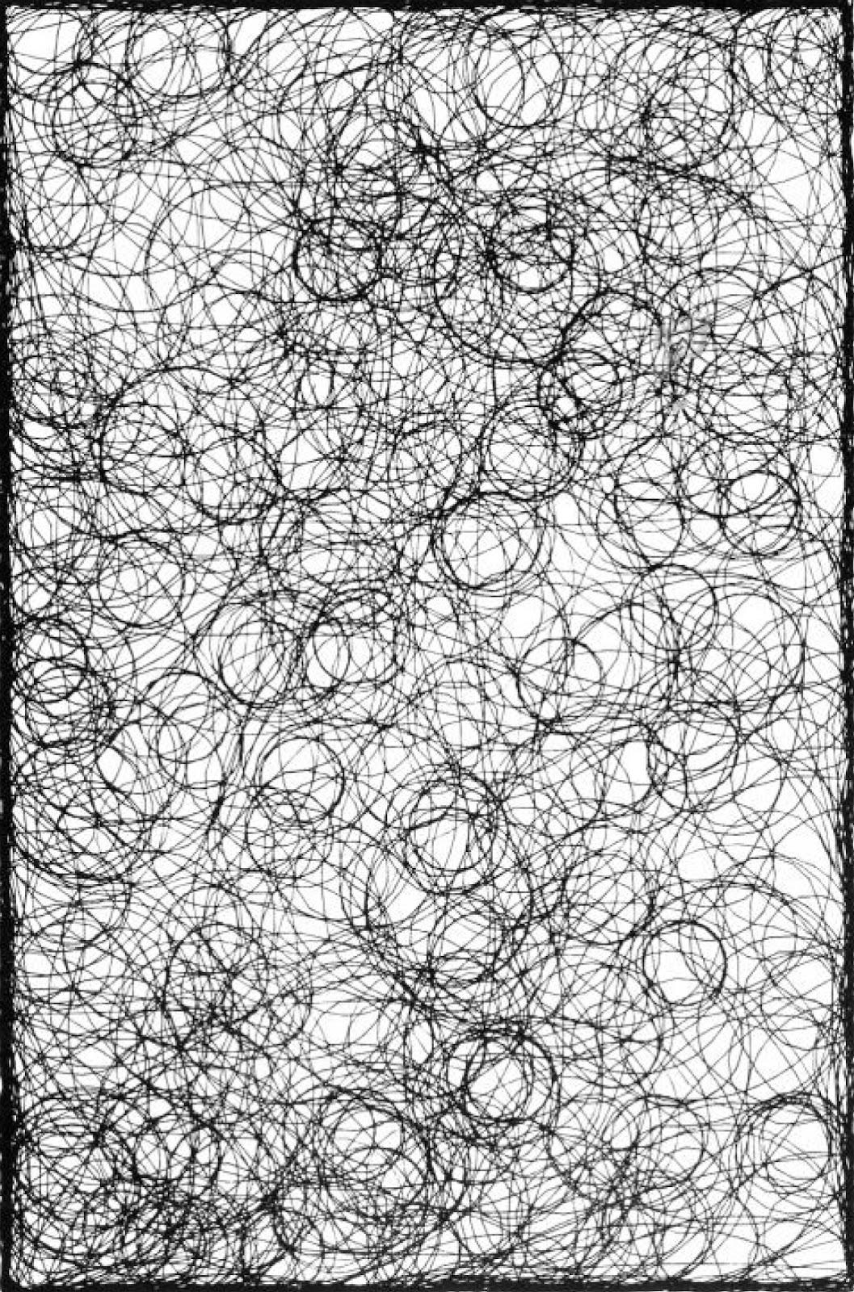
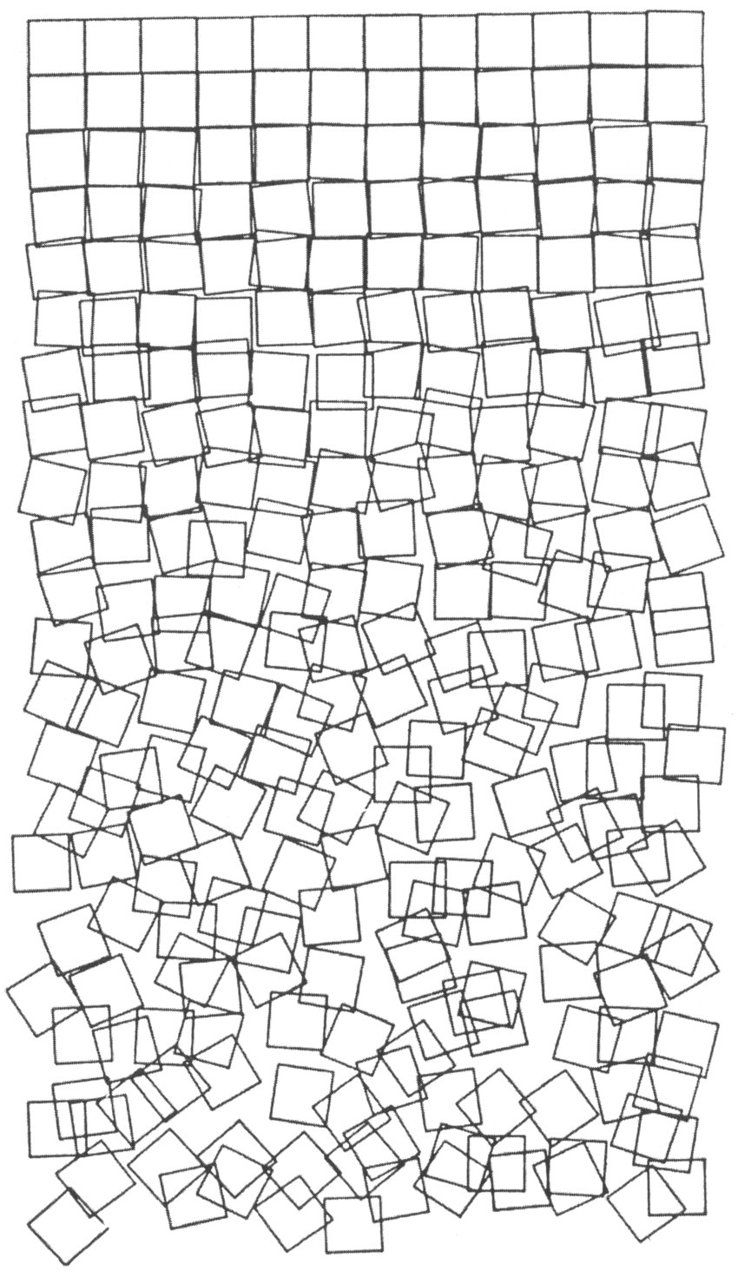
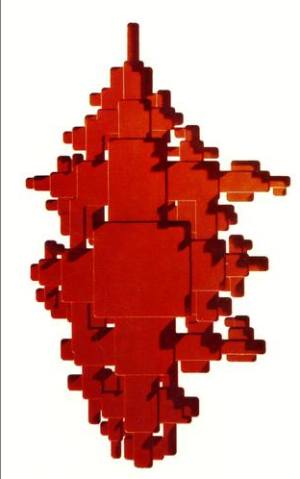
Georg Nees

Slide 5
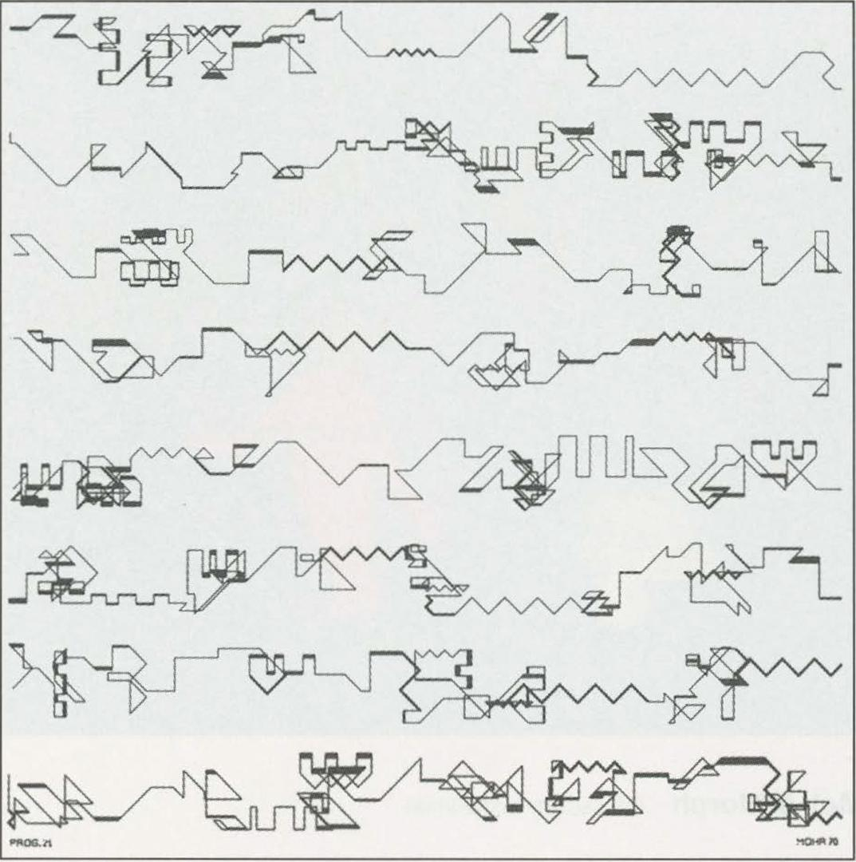
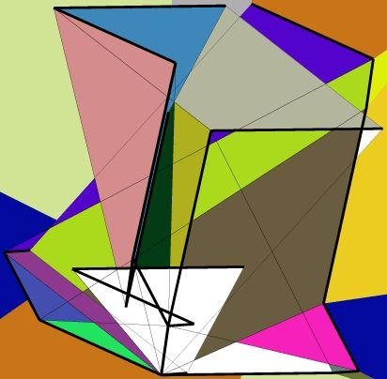
Manfred Mohr

Slide 6
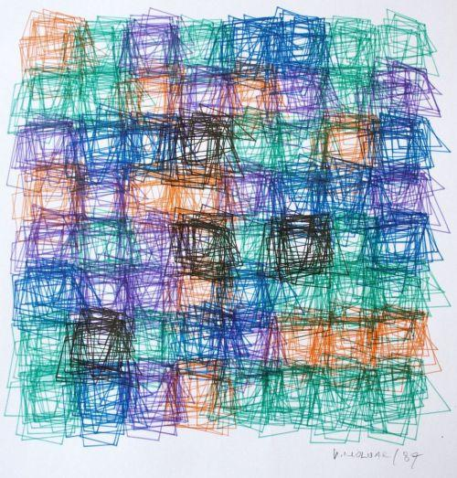
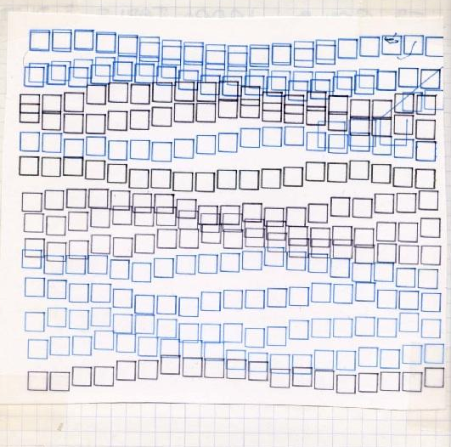
Vera Molnar

Slide 7
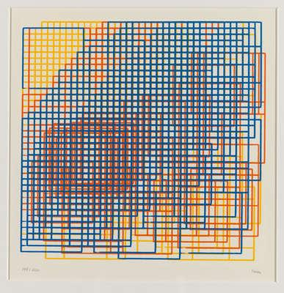
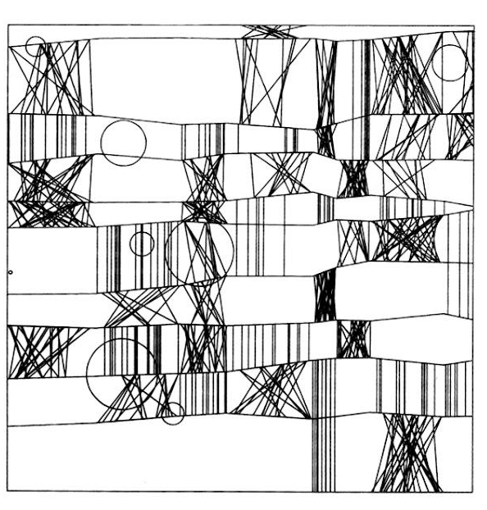
Frieder Nake

Slide 8
More artists to check out :
Manuel Barbadillo
Ben Laposky
Paul Braun
Laurie Spiegel
Kenneth Knowlton
Lillian Schwartz
Leon Harmon
Herbert W. Franke
Michael Noll
Hiroshi Kawano
Charles Csuri
Harold Cohen
Roman Verostko
Desmond Paul Henry
Mark Wilson
Bela Julesz
John Madea

Slide 9
Computational Artists 2023:
Giacomo Montiani
Junjie Huang
Chia-Hsuan Chao
Paul Jaeggi
Benhur Baiju
Joana Francisco Tomaz
Kai Hsun Yeh
Jiaxiang Luo
Wataru Nomura
Amir Ali Amini-Aghdam
Megi Sinani
Kevin Seav
Panayiotis Papacharalambous
Namdev Talluru
Sukhdevsinh Parmar
Peiro Hamid
Gonzalo Seminario Garcia

Slide 10
Computational Artists 2024:
Nicolas Benjamin Boscoboinik
Daniela Larbalestier
Lais Hotz
Alim Battal
Spyros Pyrgiotis
Marc Ribert Arqués
Ioanna Tatouli
Pluem Pongpisal
Guillem H Camarasa
Konstantina
Yen-Ting Liu
Sian-Jyun Chen
Dalila Romero Zenker
David Villegas

Slide 11
Assignment :
Submission : Monday morning (9am - 11am)
“Create your own piece of art departing from an existing one”
Prepare a brief presentation of your work
Upload your presentation to this Google Drive folder
Take a screenshot of your artwork and upload to Moodle
(Format - ComputationalArt_YourName.jpg or .png)
Upload the code as a GHX file on Moodle
(Format - ComputationalArt_YourName.ghx)

Slide 12
Computational Artists of 2020-2025

Slide 13
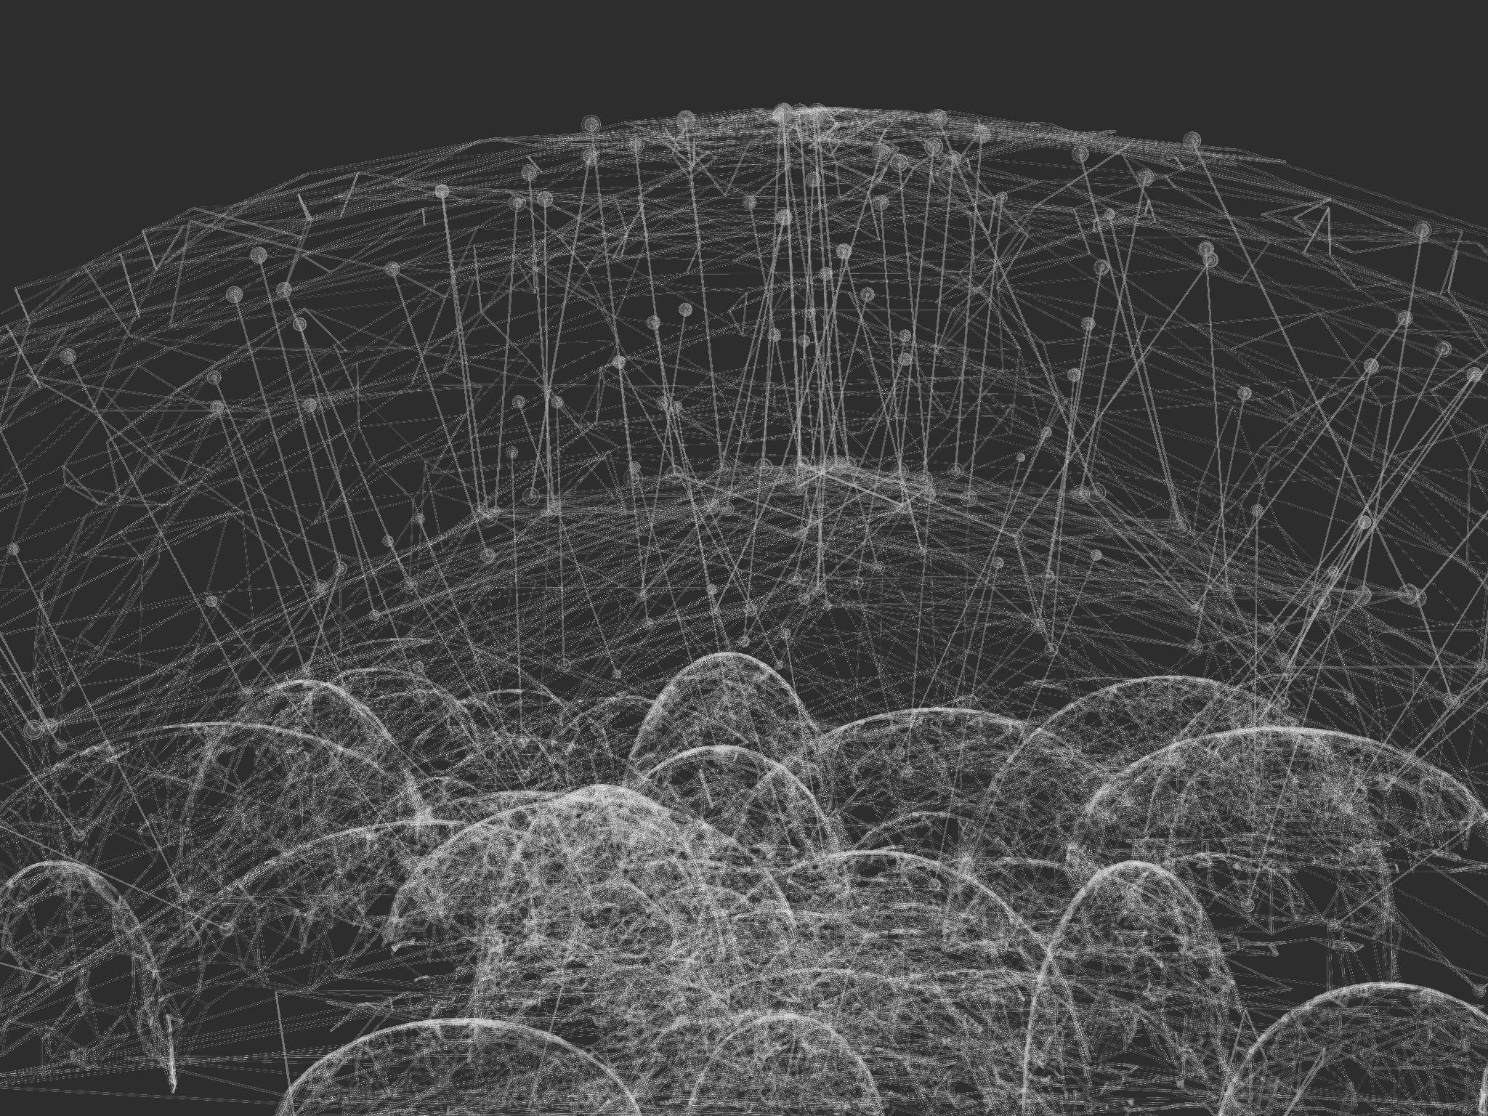
JimChen

Slide 14
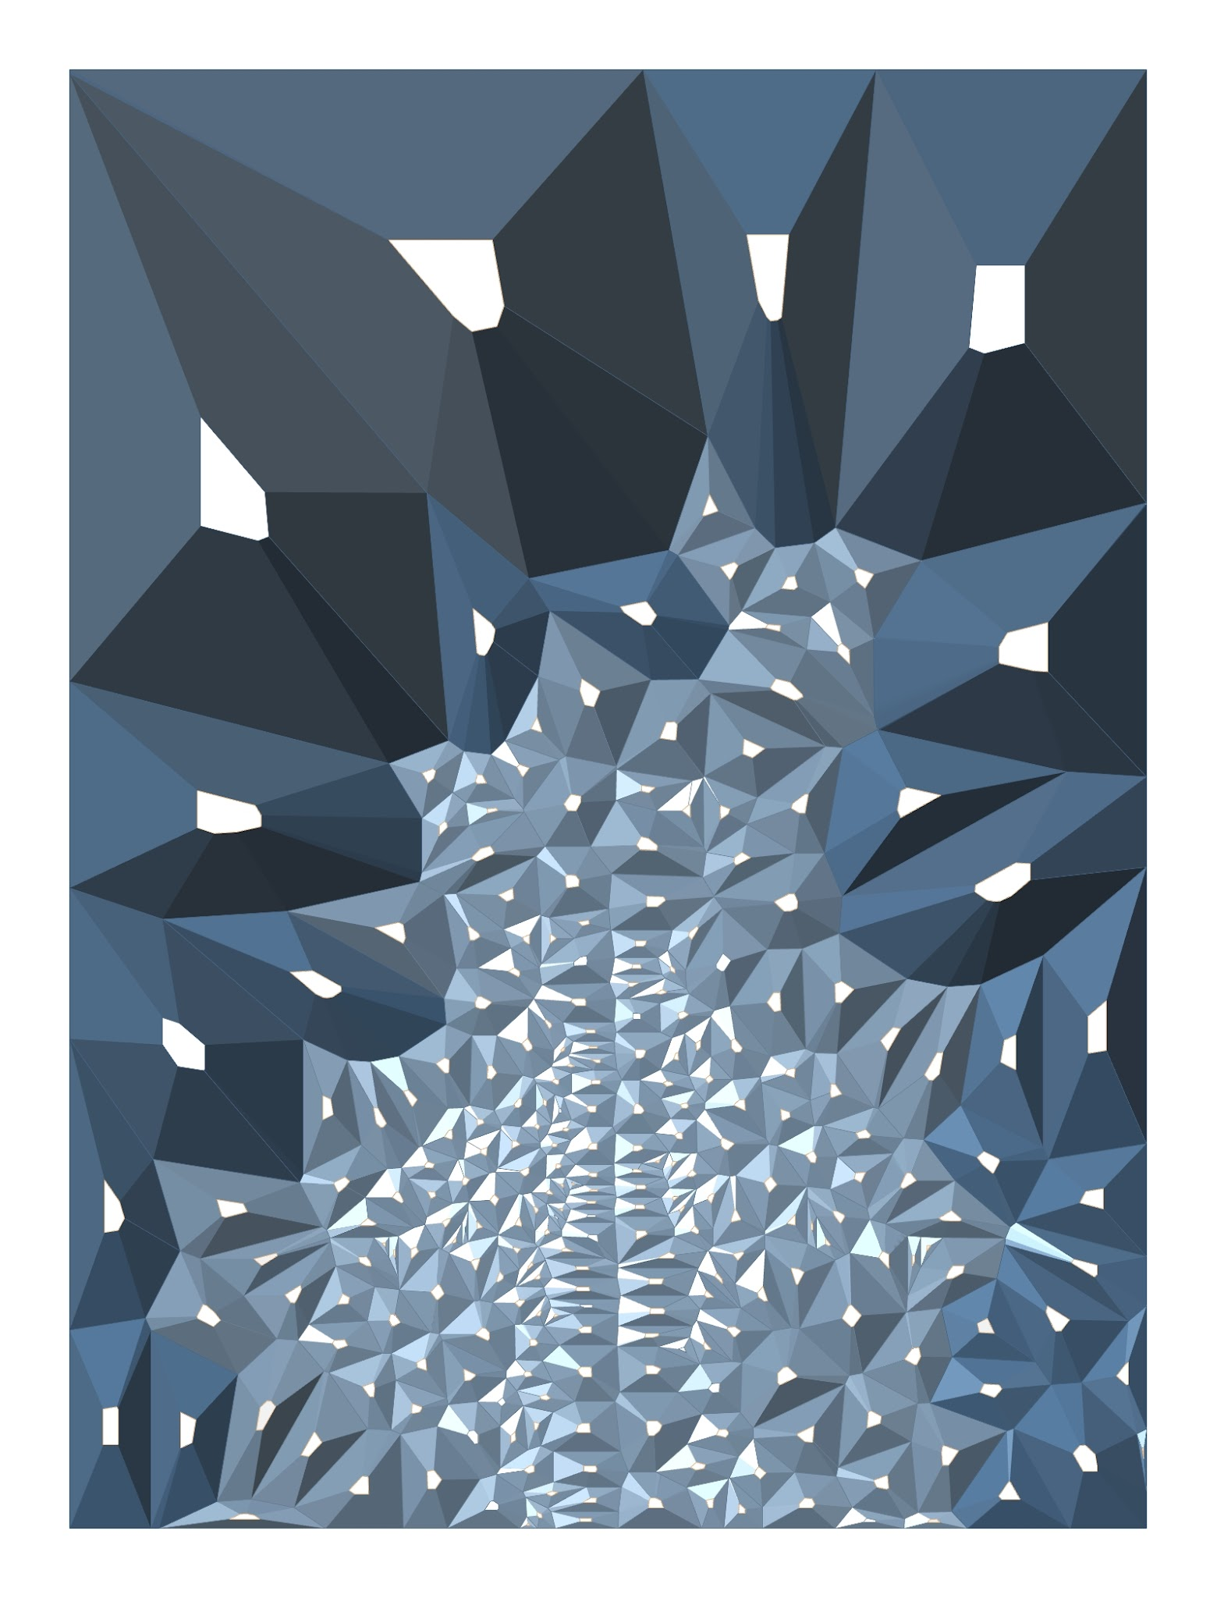
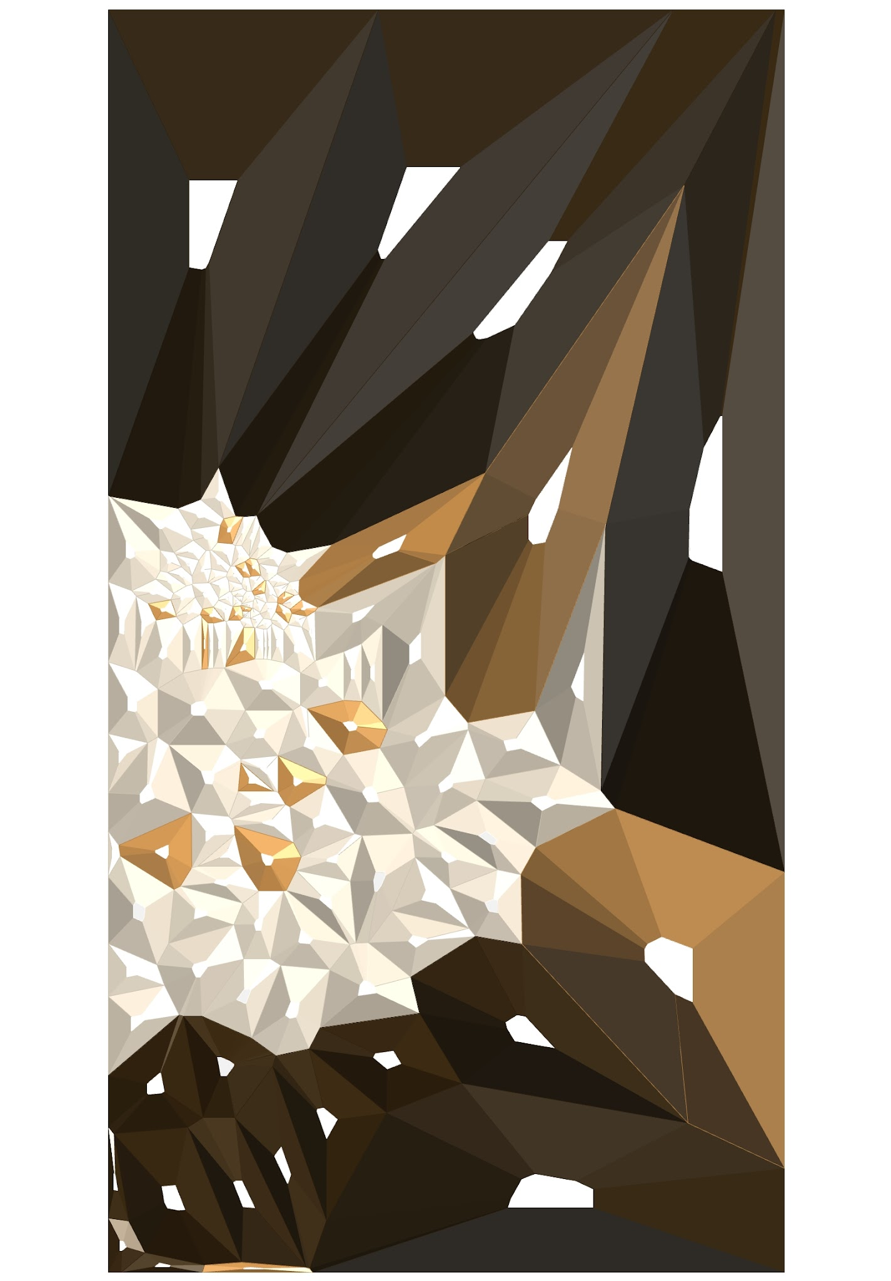
Marc Ribert

Slide 15
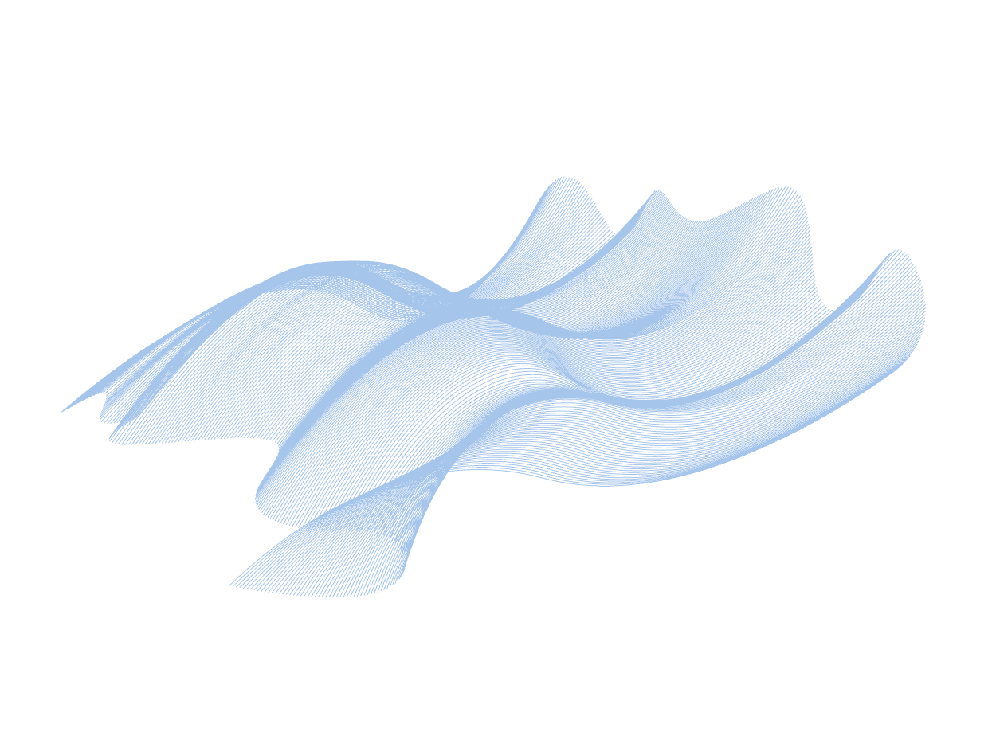
Joana Tomaz

Slide 16
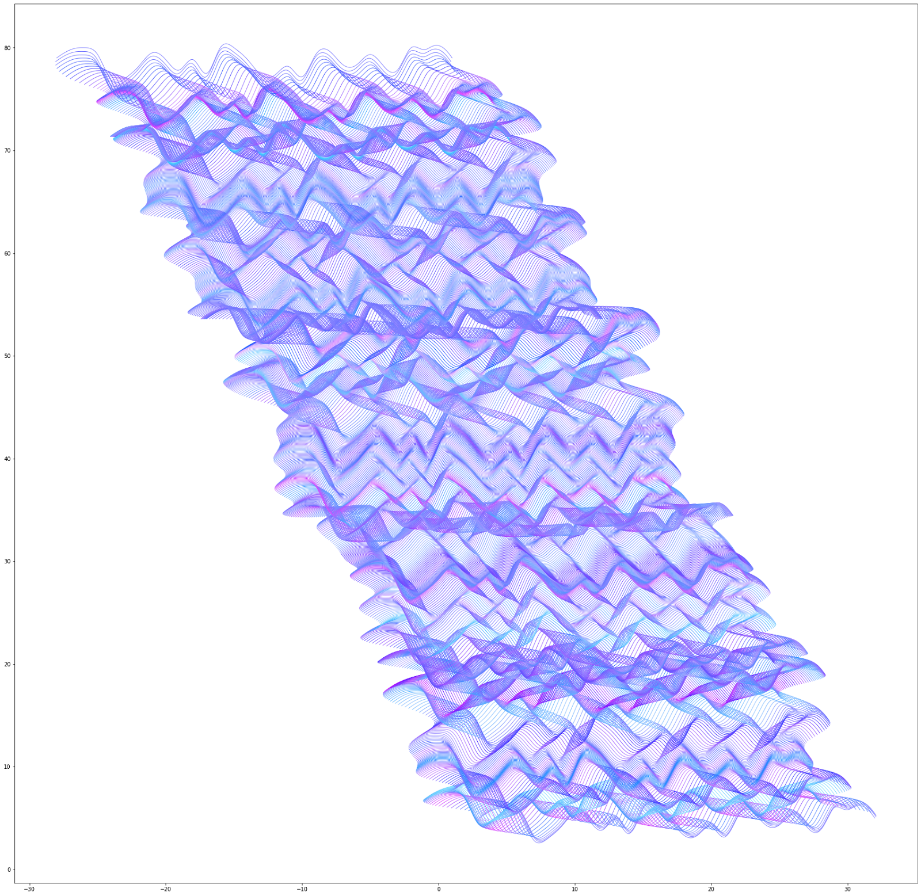
Ko Tsuruta
“Inspired by Roman Verostko, the drawing expresses the feeling when we enter a colorful labyrinth”

Slide 17
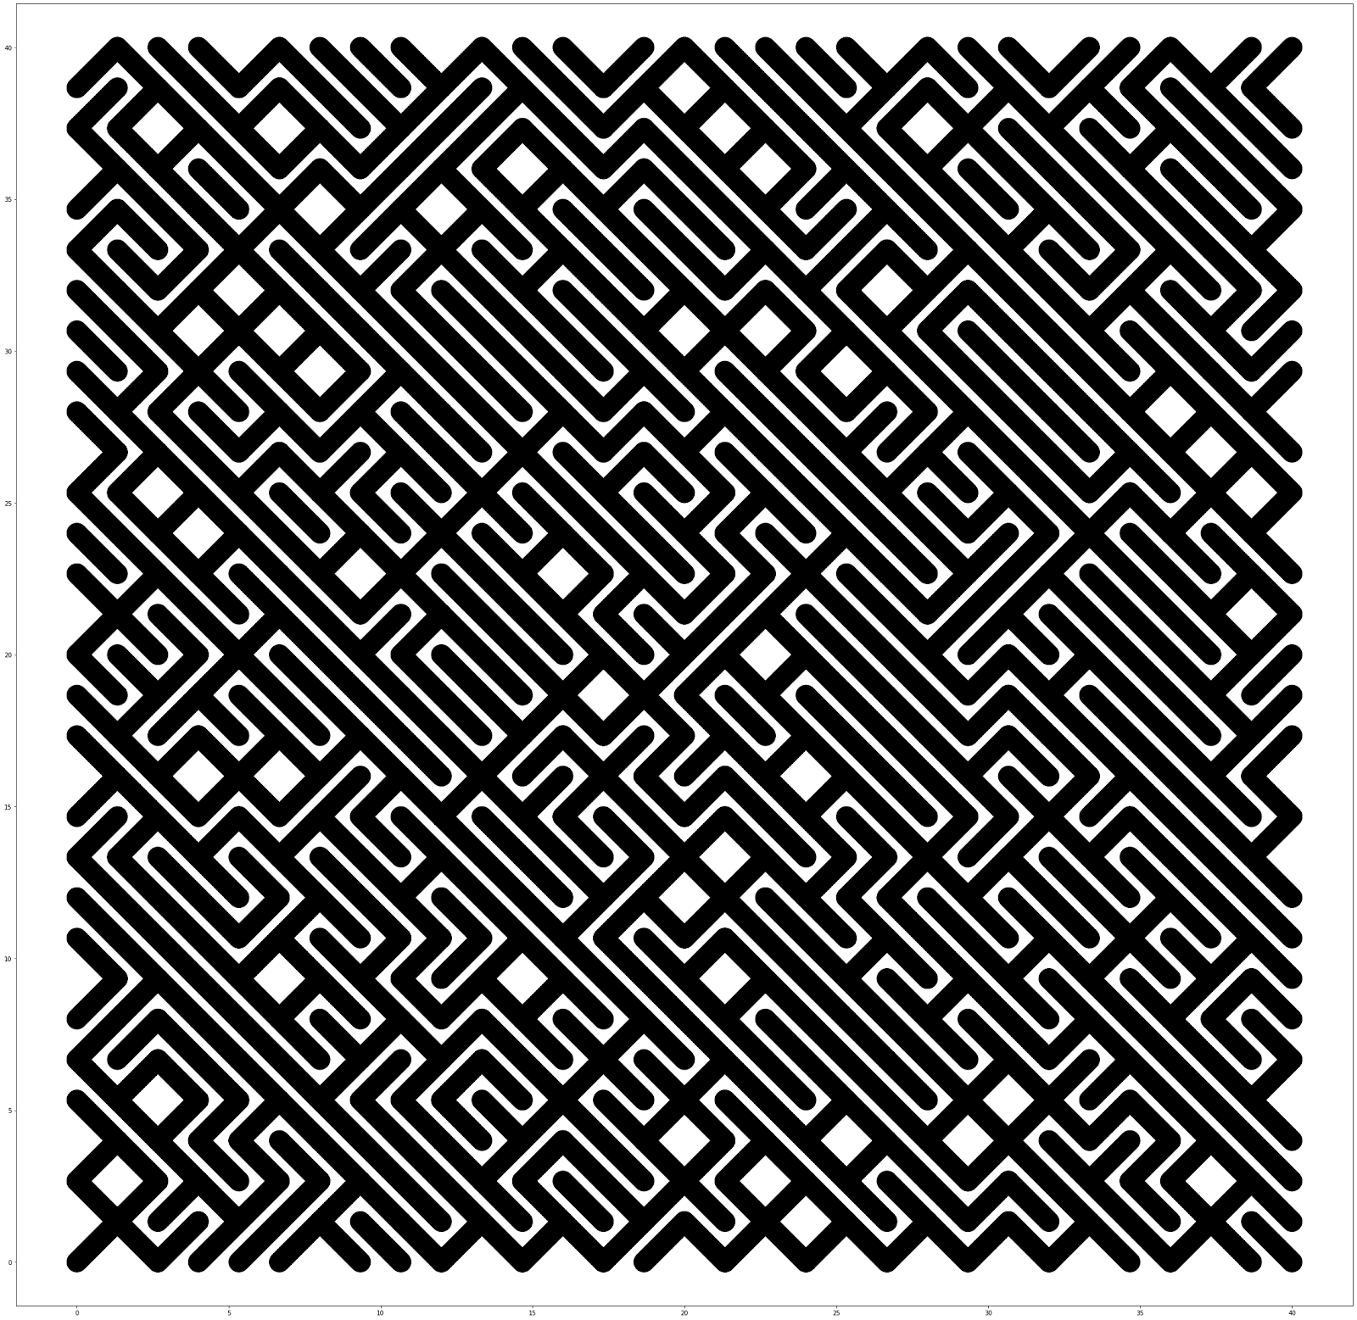
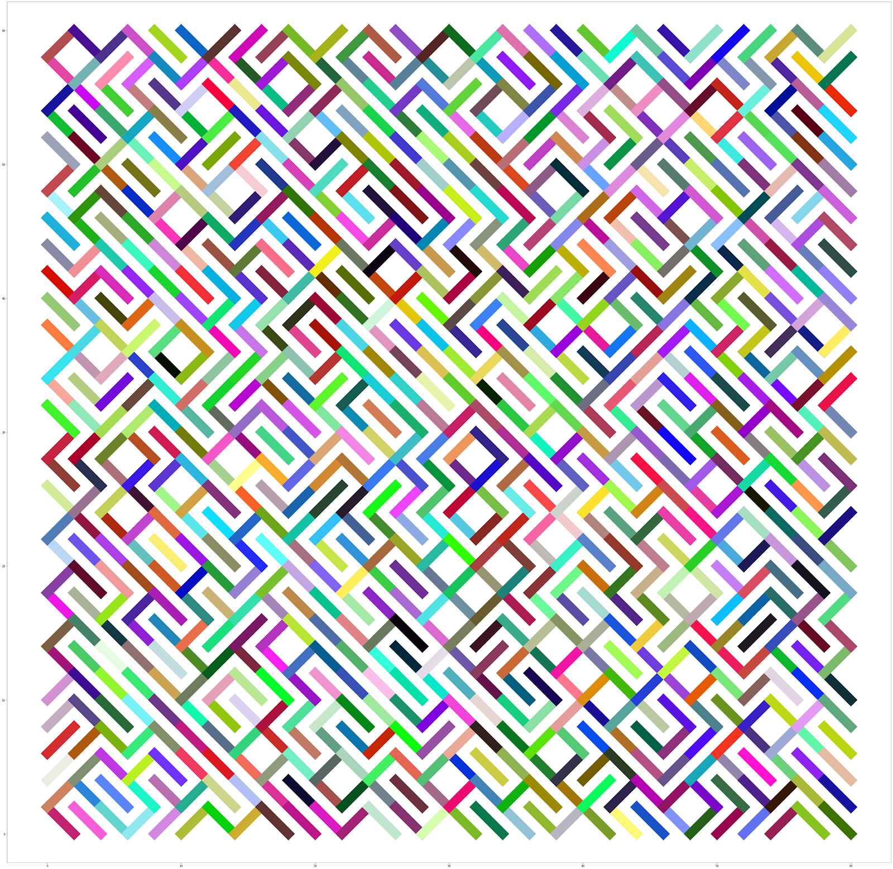
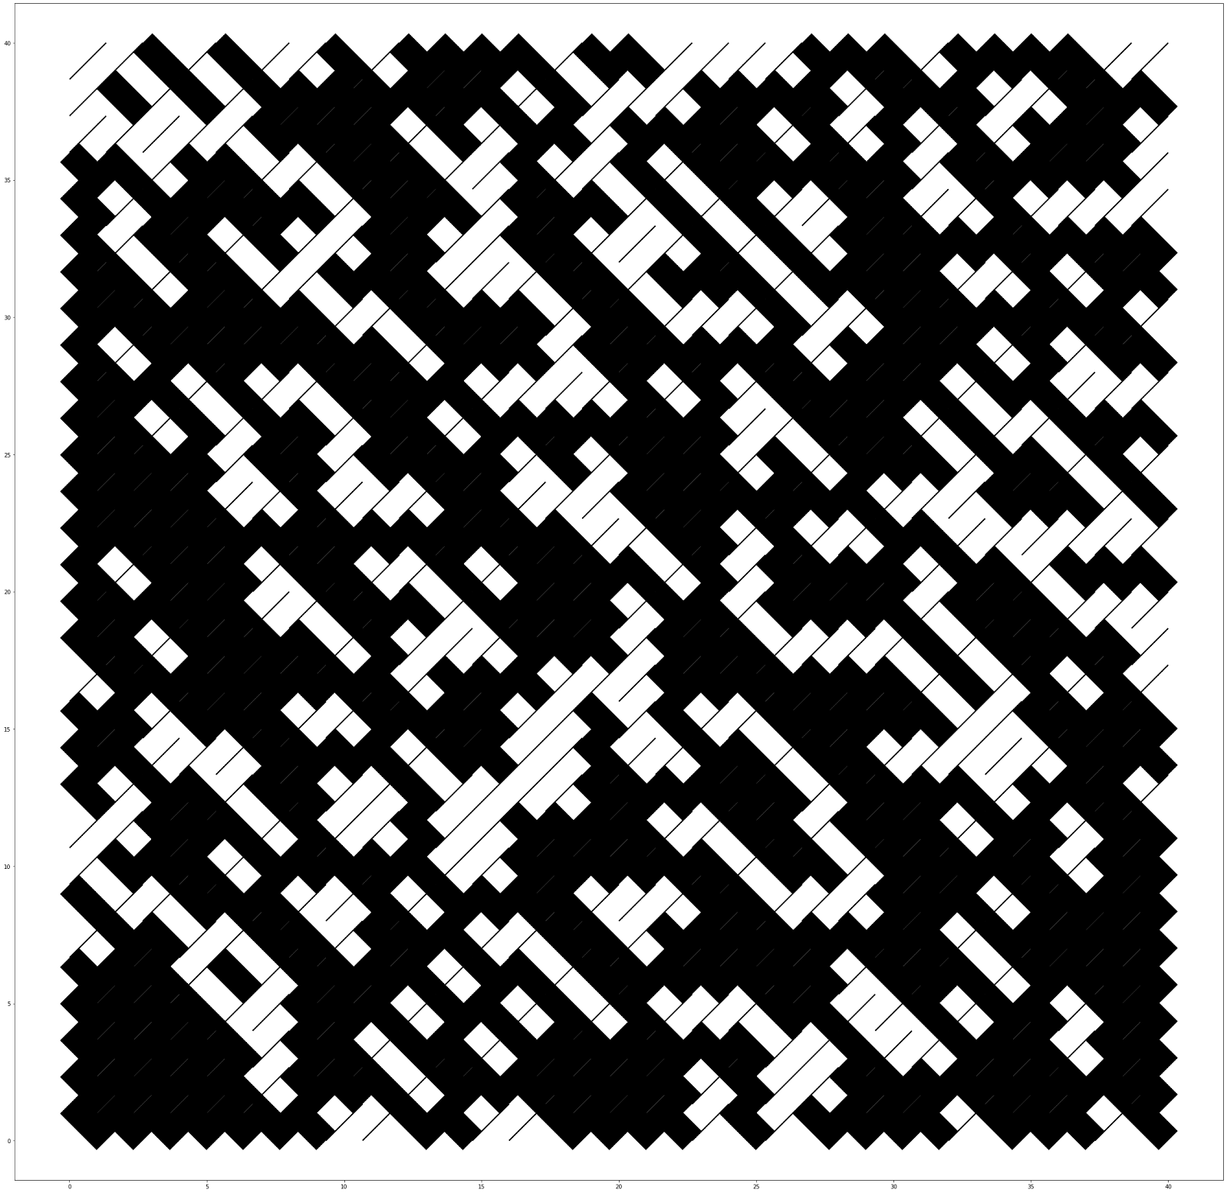
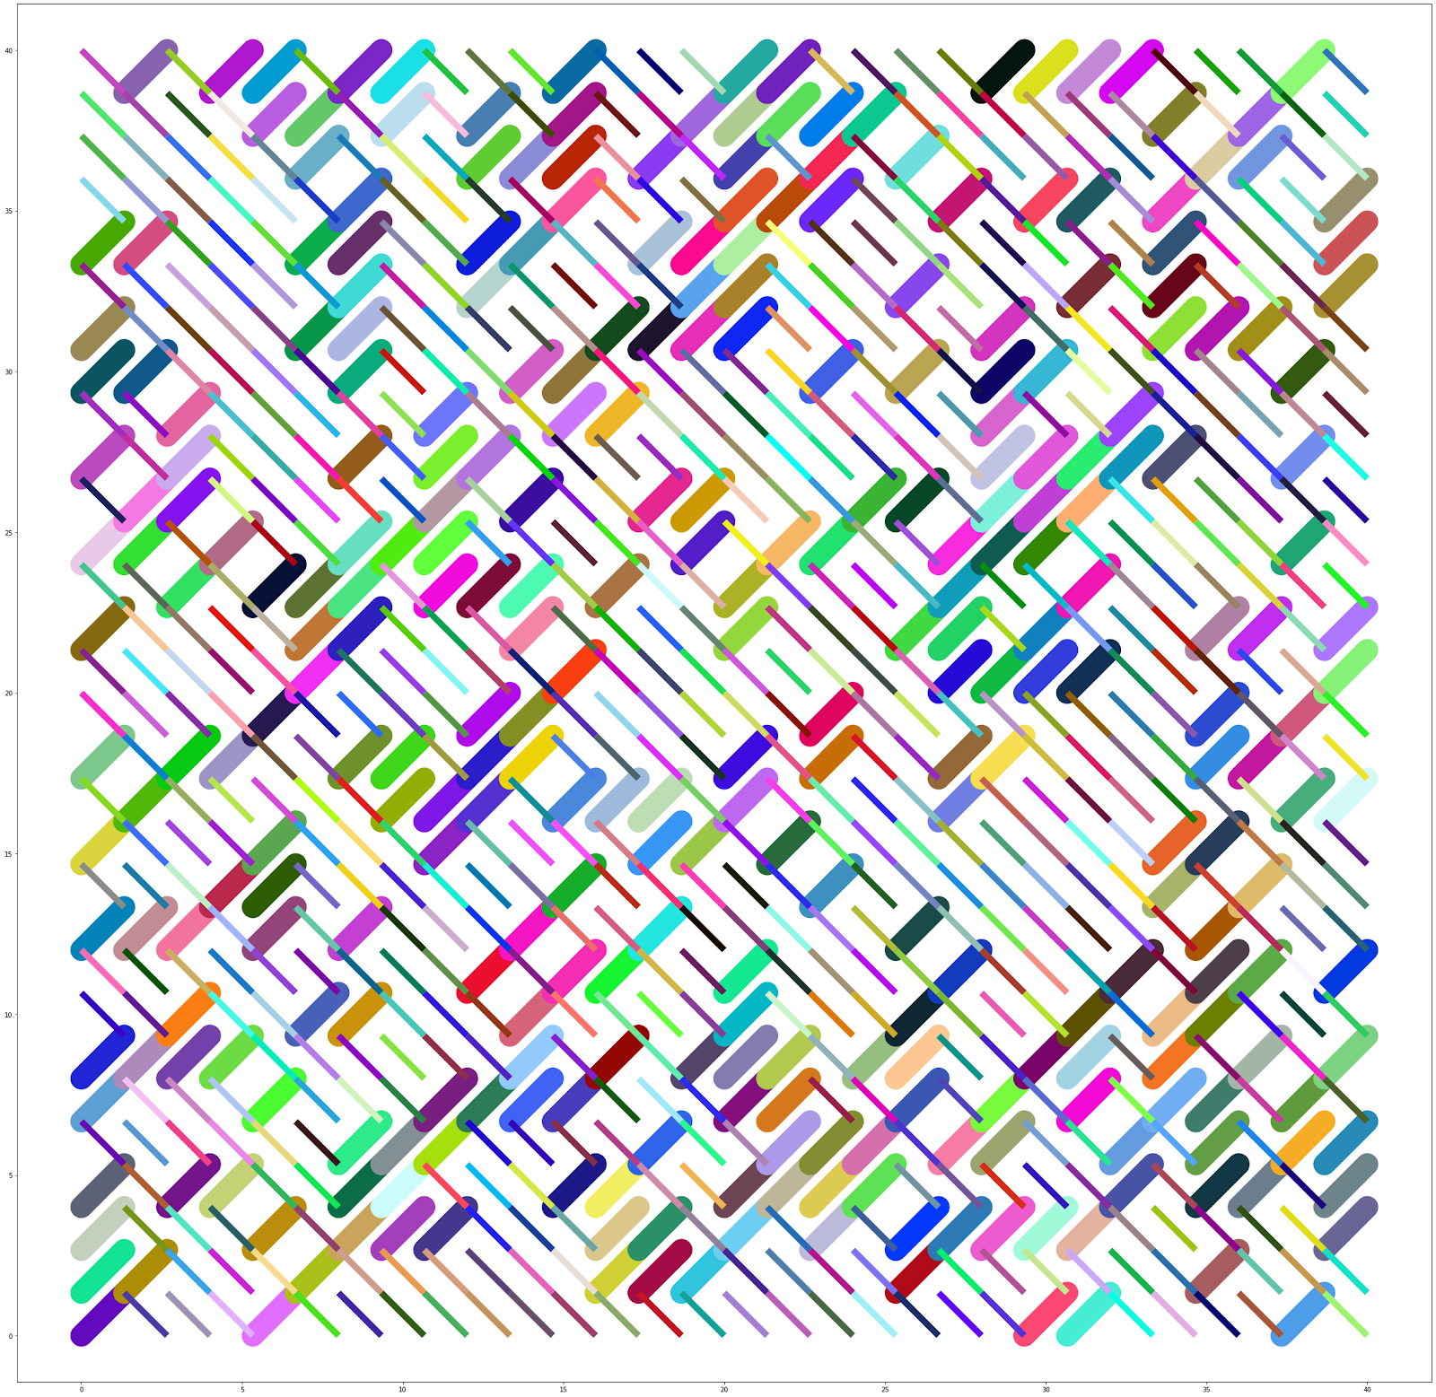
Beril Önalan
“An homage to Vera Molnar, the 'Grande Dame' of digital art”

Slide 18
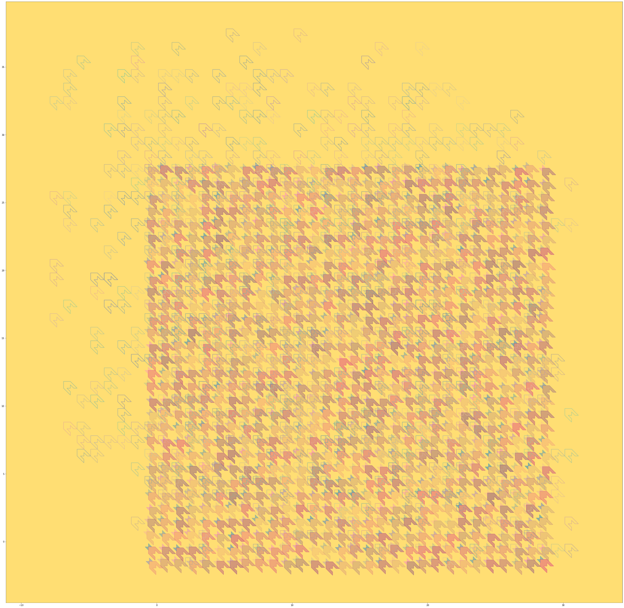
Yan Fen Chan
“Houndstooth is a duotone textile pattern characterized by broken checks or abstract four-pointed shapes, often in black and white, although other colours are used. One unit of houndstooth is a combination of 3 shapes, it's simple but after using move, rotate, random function, the whole image becomes vivid”

Slide 19
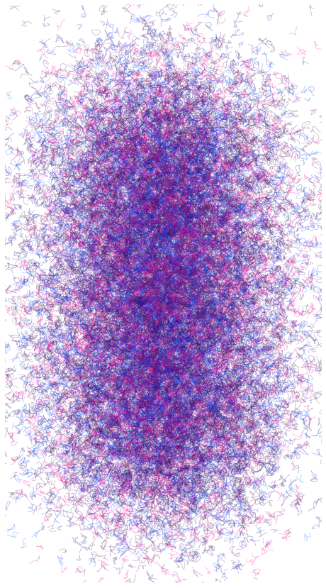
Simon Griffioen
“Inspiration : Roman Verostko
Method : B-Spline exploration, gaussian distribution”

Slide 20
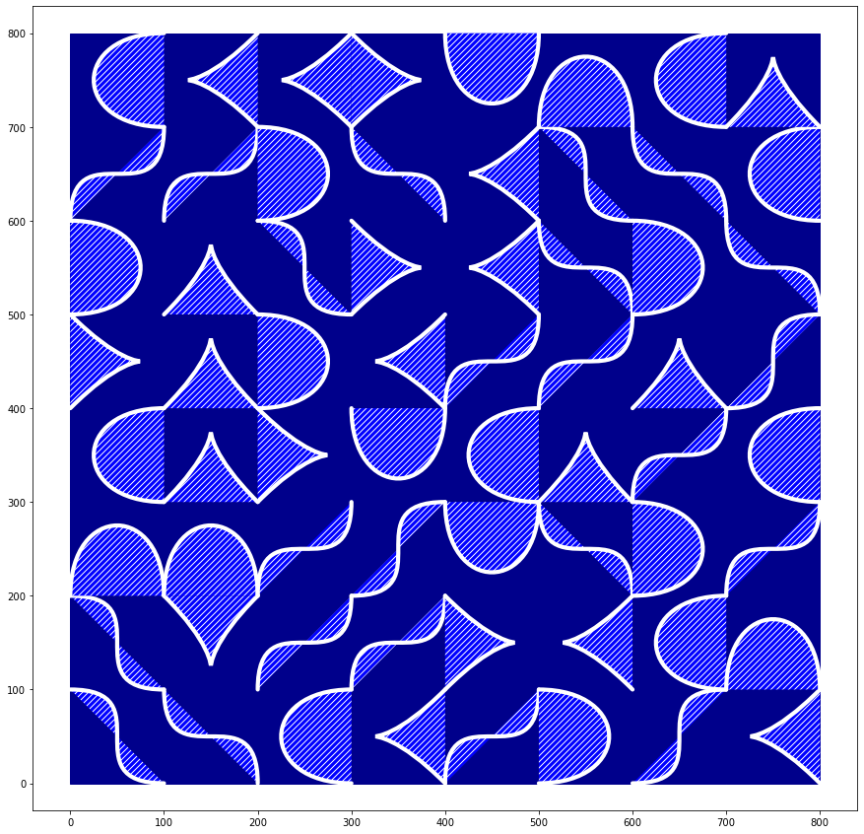
Chengyuan Wei
“Place a 4 point B-spline in a square, each point take a corner of the square. 2 points are the start and the end of the curve and an other 2 are the control points. the picking sequence is random, so within the randomness there are 4 different patterns each one has 4 different orientations, thus in total 16 variations”

Slide 21
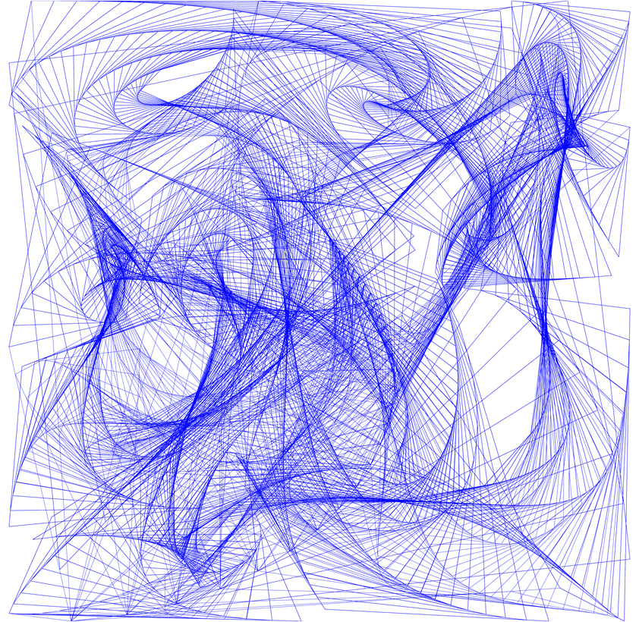
Wenjun Liu
“ Wirls into Voronoi cells, using a recursive function ”

Slide 22
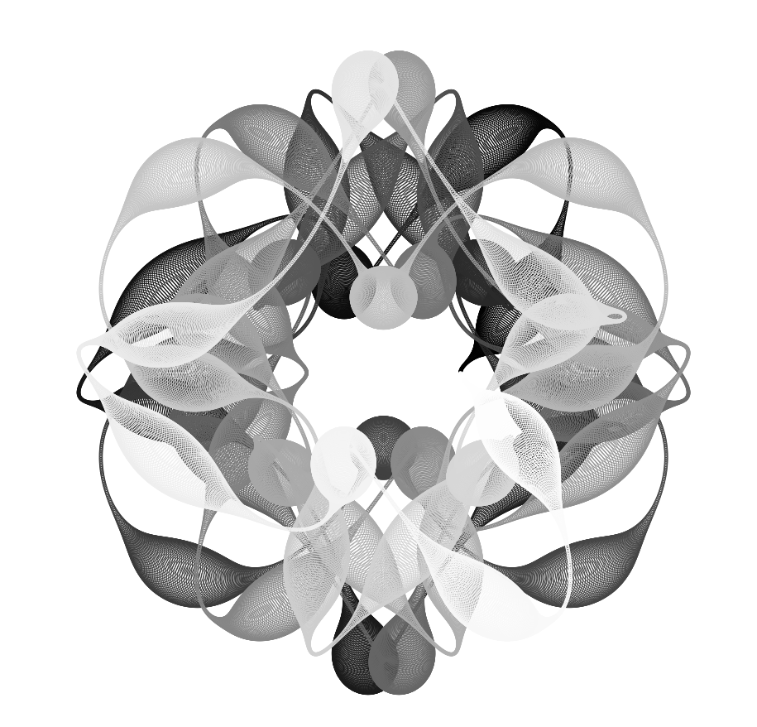
Ming Yang
“Custom Trigonometric Function with circles of varying radius”

Slide 23
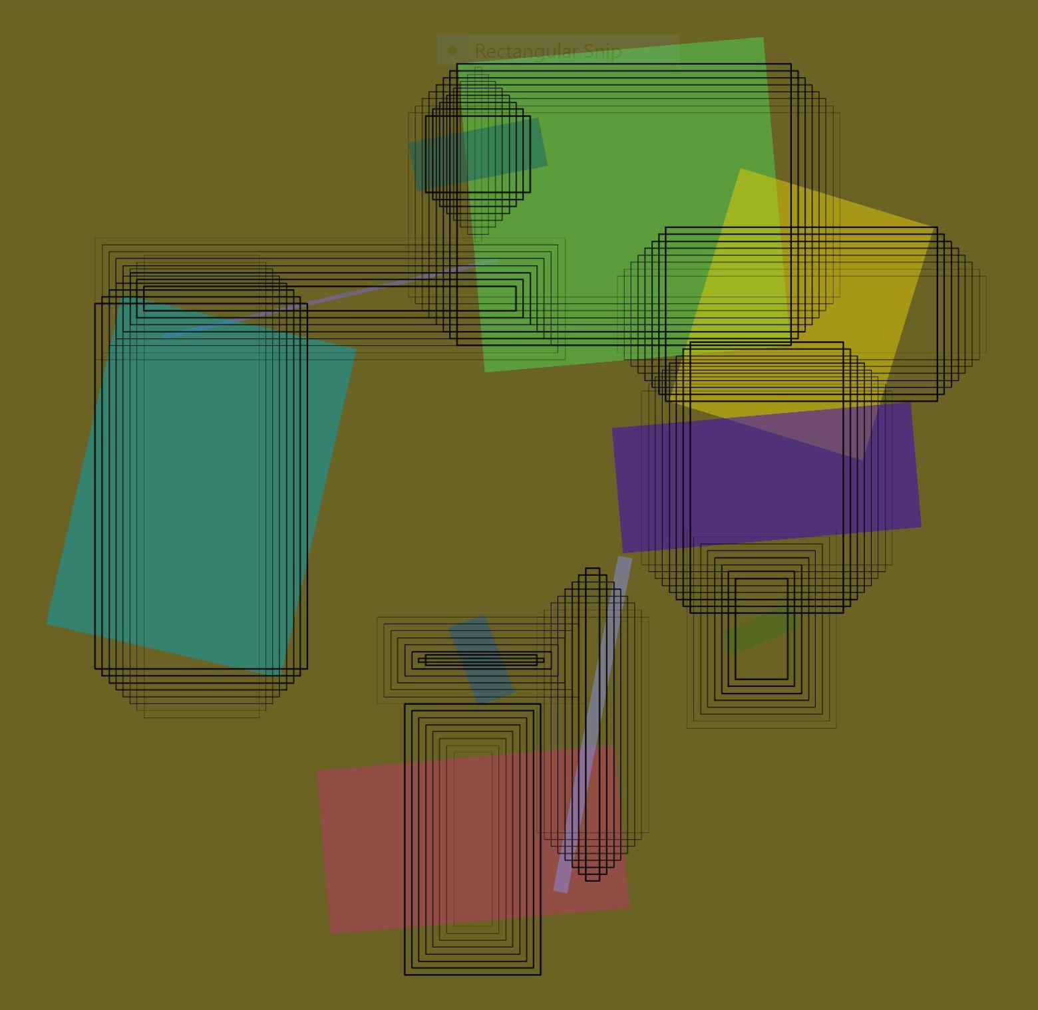
El Mehdi Belyasmine
“Archipelago of monuments, random rectangles”

Slide 24
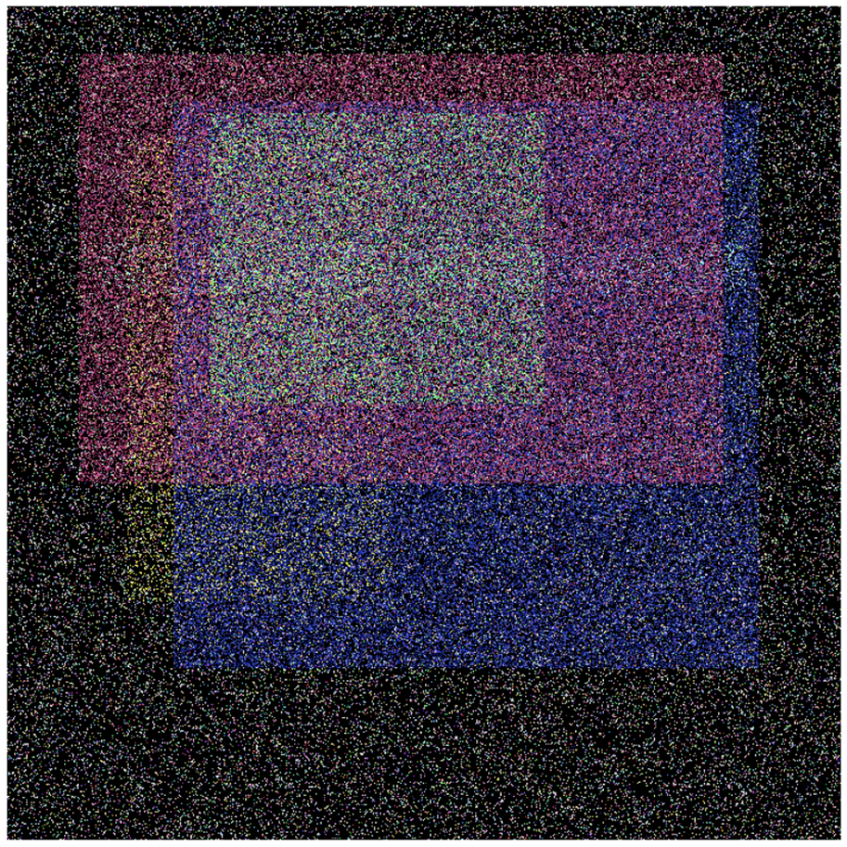
Vincent Woerndl
“Homage to Malevich, squares and noise”

Slide 25
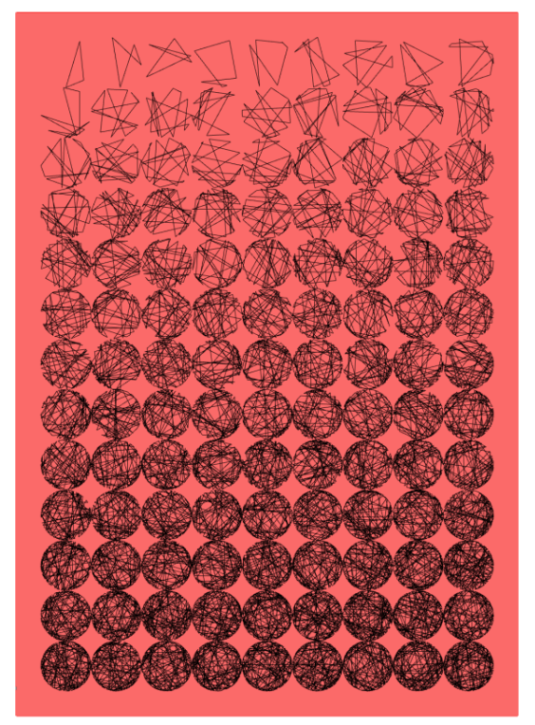
Ana Ascic
“Replication of Georg Nees (“Untitled’ [red black])”

Slide 26
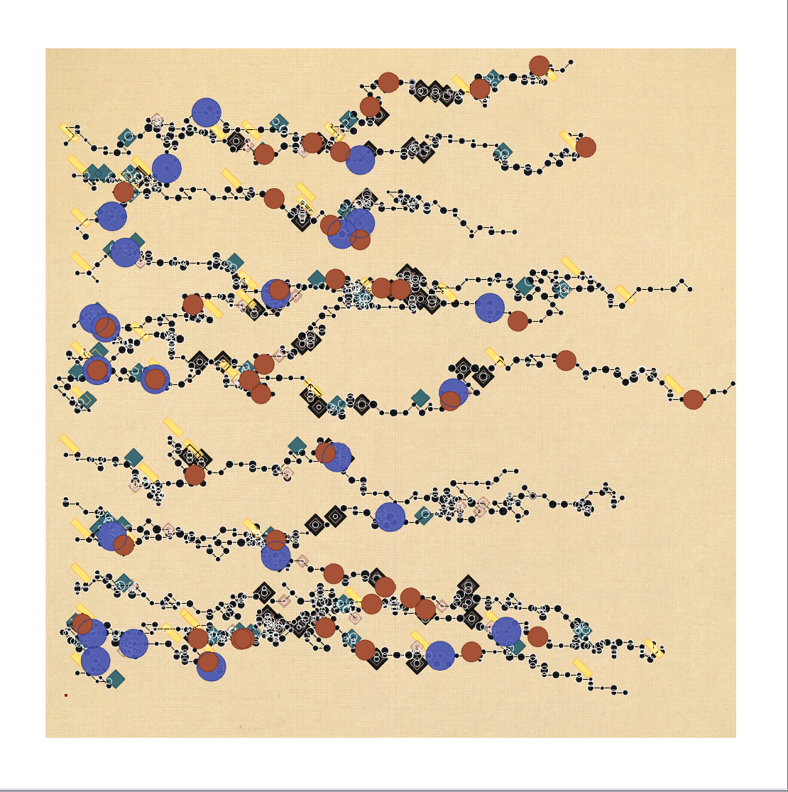
Ian Law
“Method: directed (random) walker moving from left to right. Library of shapes are used to fill in the nodes”

Slide 27
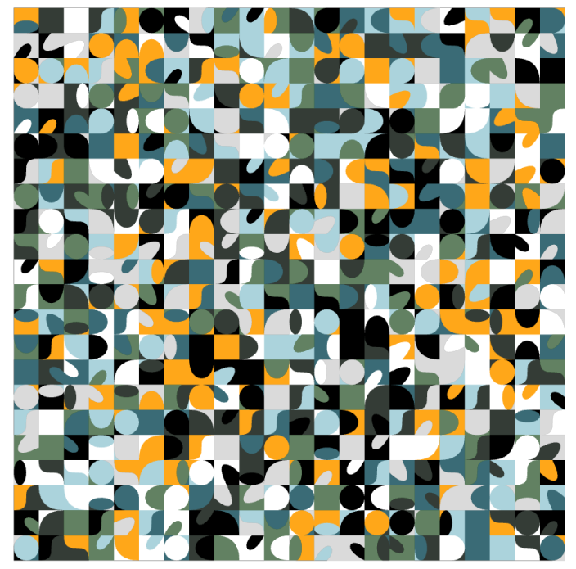
Eleni Alexi
“Roll the Dice three times”

Slide 28
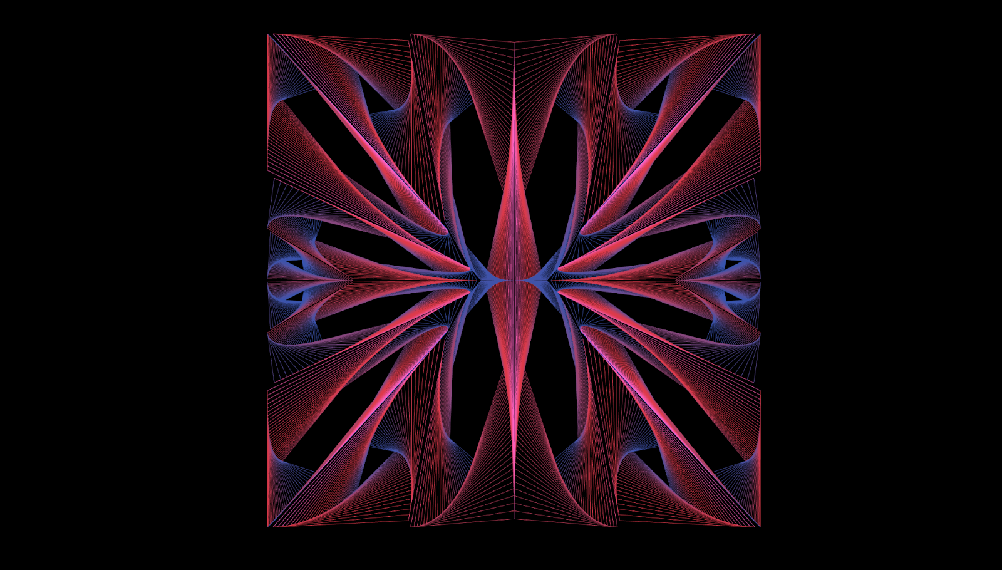
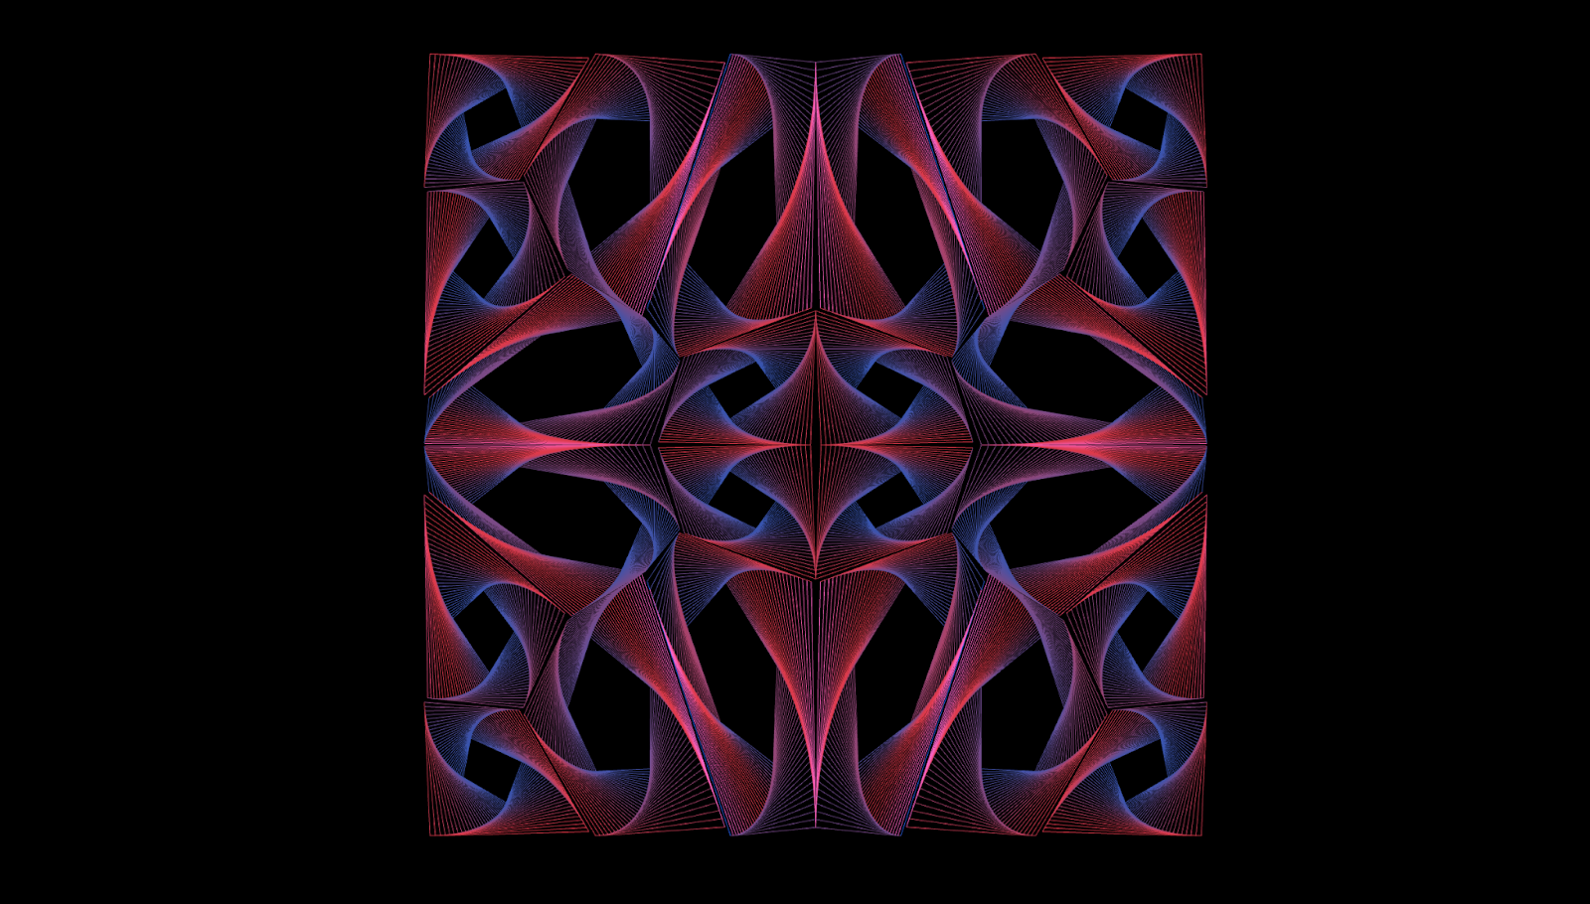
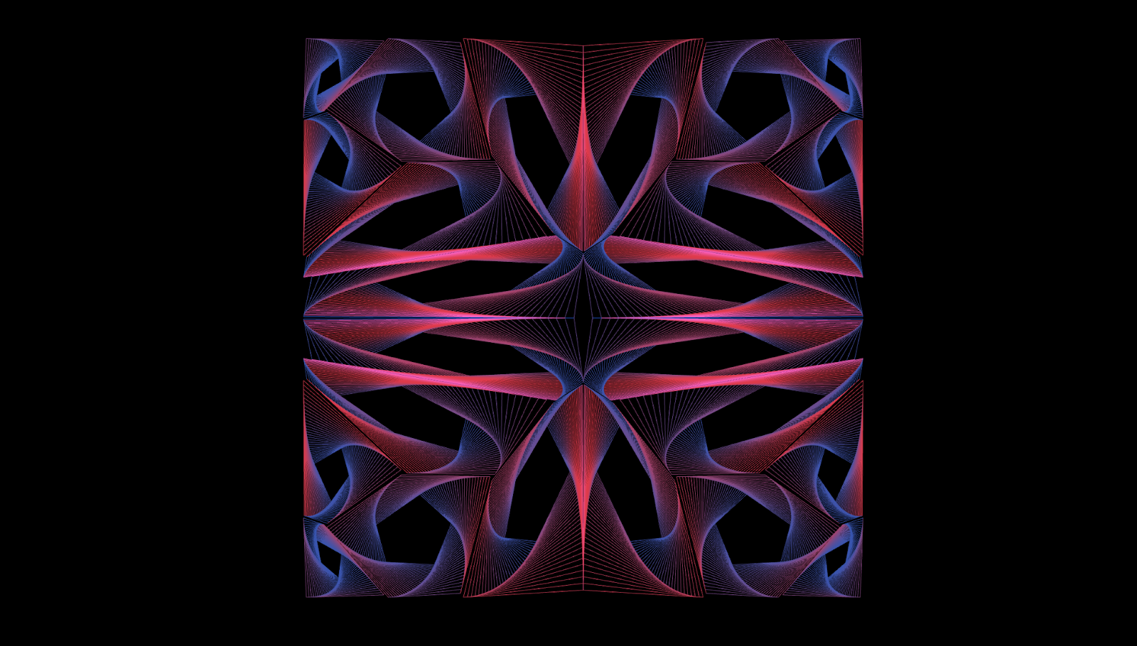
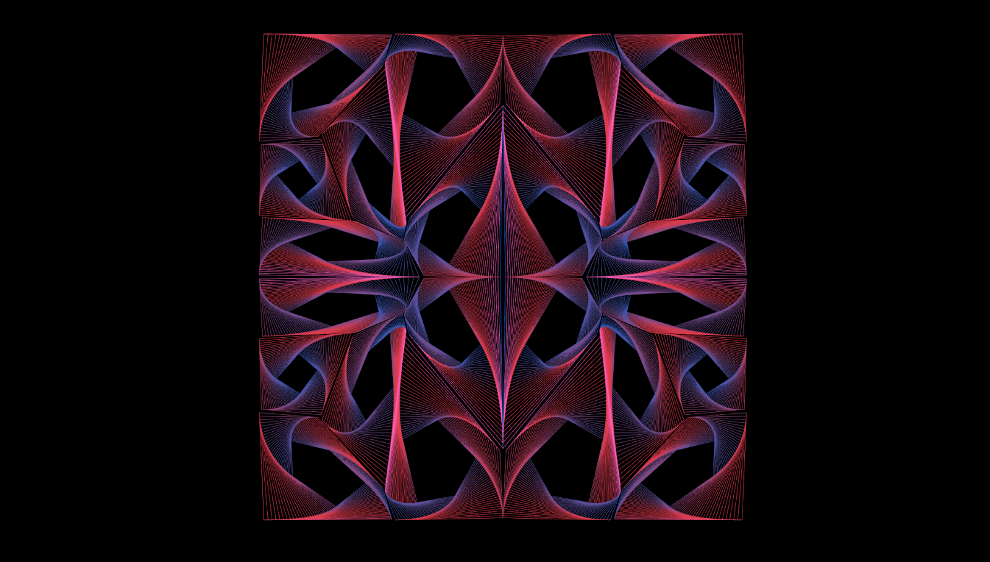
Jerry Lee
“Recursion method”

Slide 29
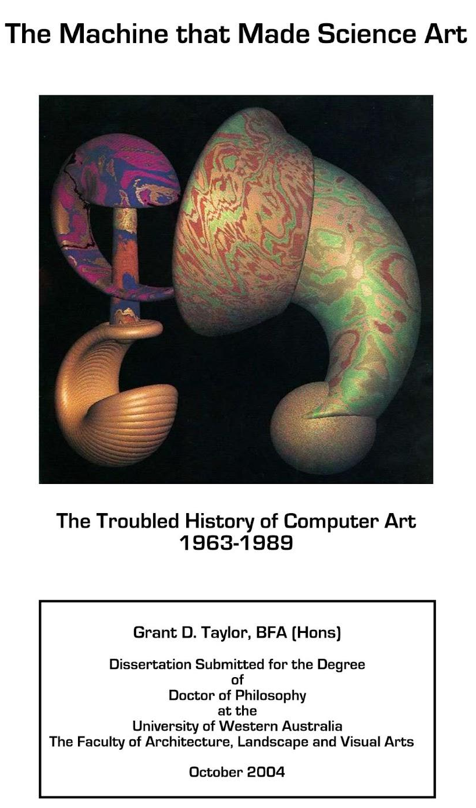
Books?

